Slide 1
Voronoi-Based Coverage Control of Pan/Tilt/Zoom Camera Networks
Multirobot Systems - Students presentation

Slide 2
Introduction
A reactive coverage control for PTZ camera networks is provided, given an event distribution over a convex environment.

Slide 3
Introduction
New spatial sensing quality measures
Conic Voronoi diagrams introduced to solve camera network allocation
Greedy gradient algorithm for continuous- and discrete-time first-order PTZ camera dynamics

Slide 4

Spatial Sensing Models for PTZ Cameras

Slide 5
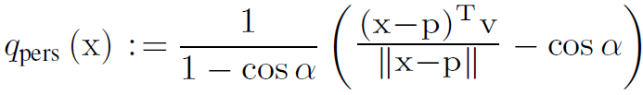
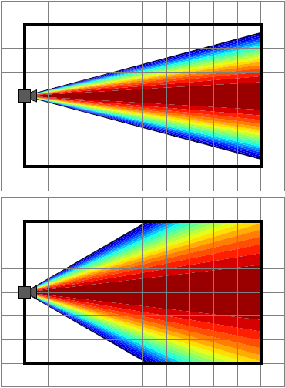
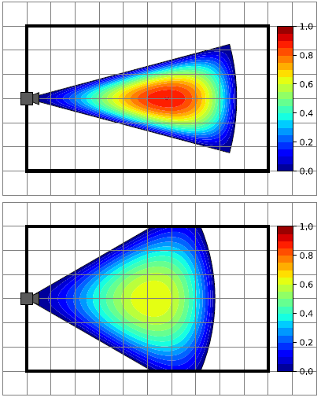
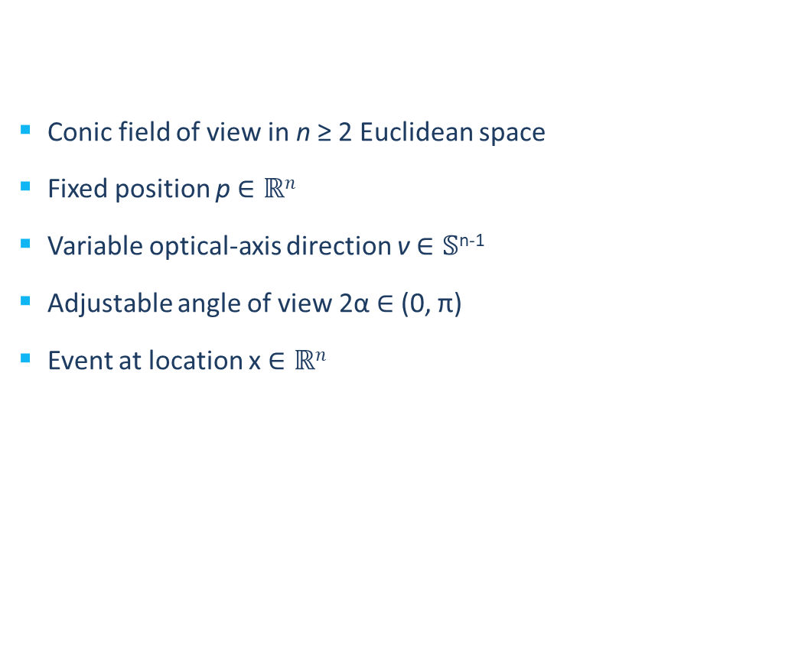
Perspective quality
Conic field of view in n ≥ 2 Euclidean space
Fixed position p $∈ℝn$
Variable optical-axis direction v $∈𝕊$^{n-1}
Adjustable angle of view 2α $∈$ (0, π)
Event at location x $∈ℝn$

Slide 6
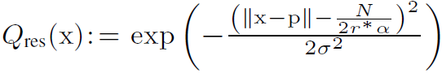
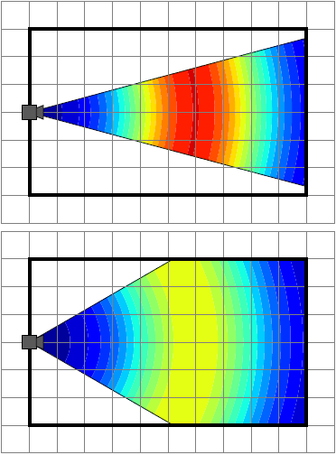
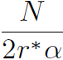
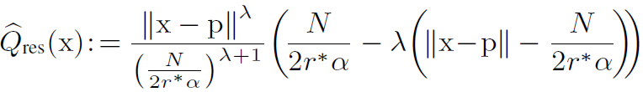
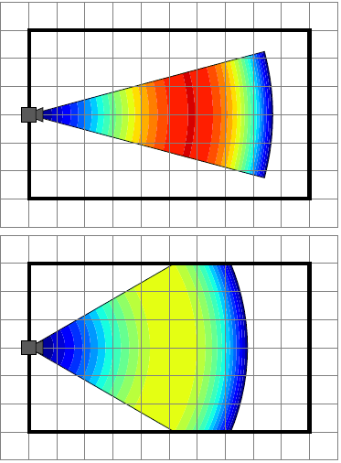
Resolution Quality
Unlimited range
Desired sensing depth:
Spatial resolution variability:
σ > 0, κ > 0, λ ≥ 0
Limited range

Slide 7
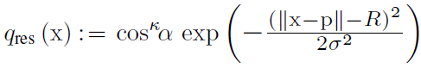
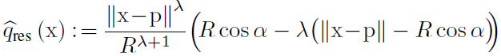
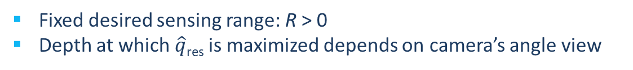
Simplified resolution quality
Unlimited range
Limited range
Fixed desired sensing range: R > 0
Depth at which $\hat{q}$_{res} is maximized depends on camera’s angle view

Slide 8
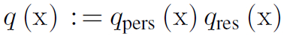
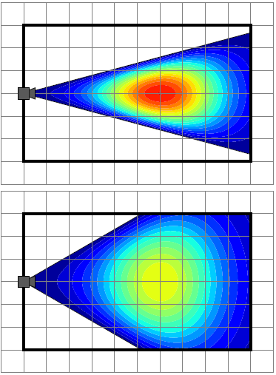
Spatial sensing quality
Unlimited range

Slide 9
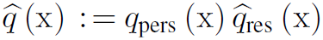
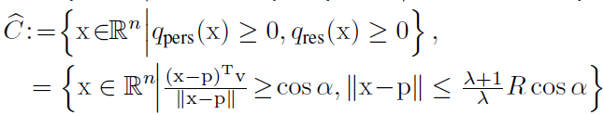
Spatial sensing quality
limited range

Slide 10

Optimal Sensor Allocation in PTZ Camera Networks

Slide 11
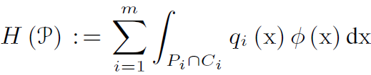
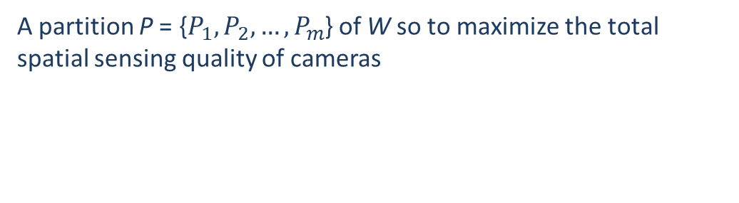
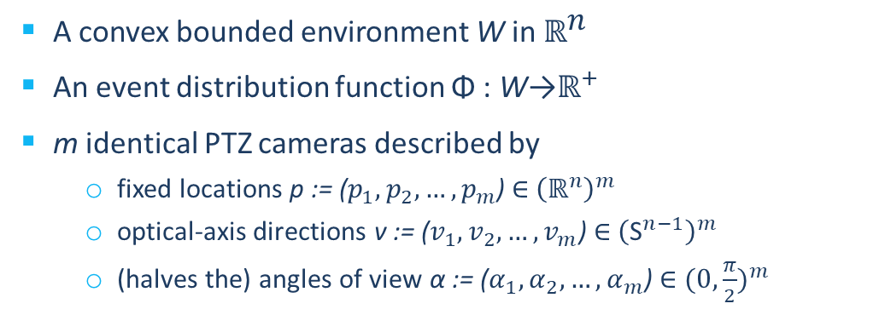
Coverage objective
Given:
A convex bounded environment W in ${\text{ℝ}}^{\text{n}}$
An event distribution function $\text{Φ}$: W→${\text{ℝ}}^{+}$
m identical PTZ cameras described by
fixed locations p := ($p_{1}, p_{2}, …, p_{m}$) ∈ ${\left({\text{ℝ}}^{n}\right)}^{m}$
optical-axis directions v := ($v_{1}, v_{2}, …, v_{m}$) ∈ ${\left({\text{S}}^{n−1}\right)}^{m}$
(halves the) angles of view α := ($α_{1}, α_{2}, …, α_{m}$) ∈ ${(0, \frac{π}{2})}^{m}$
Find:
A partition P = {$P_{1}, P_{2},…, P_{m}$} of W so to maximize the total spatial sensing quality of cameras

Slide 12
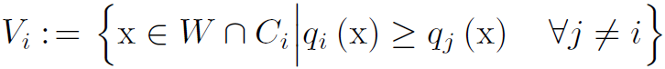
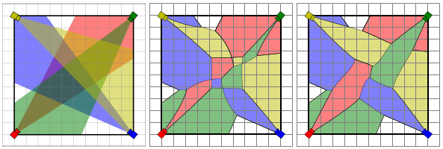
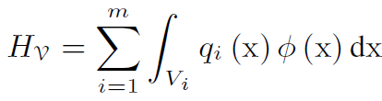
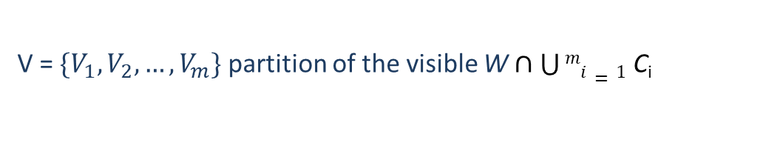
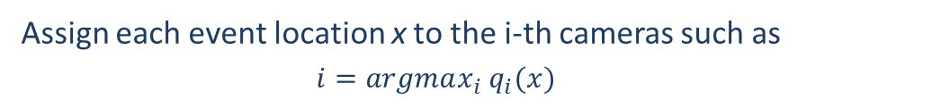
Conic Voronoi diagrams
Optimal allocation strategy
Assign each event location x to the i-th cameras such as
$$i=argmax_{i} q_{i}(x)$$
conic Voronoi diagram of W
V = $\{V_{1}, V_{2}, …, V_{m}\}$ partition of the visible W $∩\bigcup{mi=1}$ C_{i}
utility function in new form

Slide 13
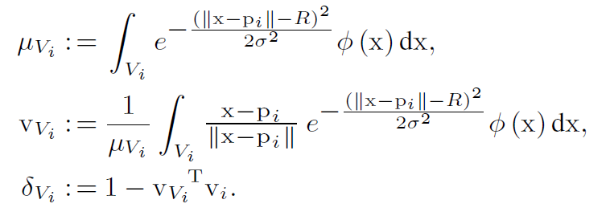
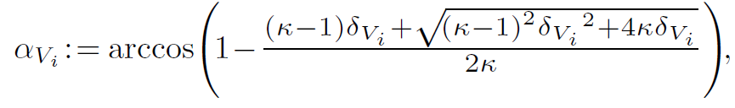
Locally Optimal Coverage Configurations
Unlimited-Range Visual Sensing
Mass
Centroidal perspective
Centroidal aperture
Centroidal angle of view
Theorem
For unlimited-range visual sensing, a PTZ camera network configuration is locally optimal in the sense of H_{V} if and only if all cameras look towards their centroidal perspectives with centroidal angles of view.

Slide 14
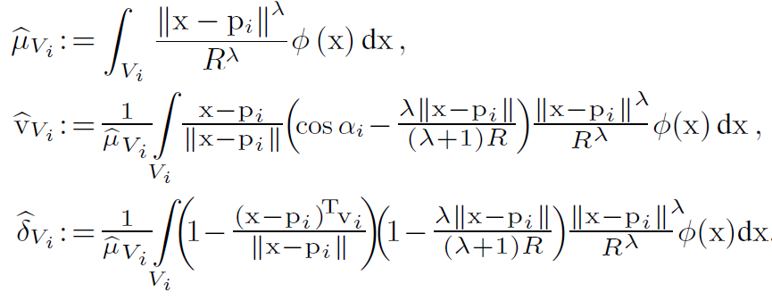
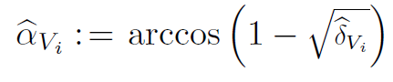
Locally Optimal Coverage Configurations
limited-Range Visual Sensing
Mass
Centroidal perspective
Centroidal aperture
Centroidal angle of view
Theorem
For limited-range visual sensing, at a locally optimal PTZ camera coverage configuration of H_{V} , all cameras are directed at the centroidal perspectives of their respective Voronoi cells with the associated centroidal angles-of-views.

Slide 15

Coverage control of PTZ cameras

Slide 16
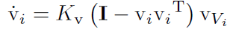
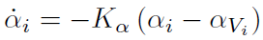
Continuous-Time Camera Dynamics
“move-to-centroidal-perspective” and “move-to-centroidal-angle-of-view” control laws
Theorem
The continuously differentiable laws leave camera’s angles of view, 2αi, positively invariant in (0, π), and asymptotically bring a PTZ
camera network to a locally optimal coverage configuration of H_{V} while strictly increasing the total coverage quality H_{V} along the way.

Slide 17
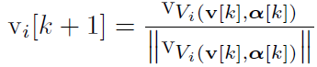
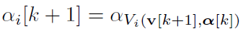
Discrete-time Camera Dynamics
“move-to-centroidal-perspective” and “move-to-centroidal-angle-of-view” control laws
Theorem
The total coverage quality H_{V} of a PTZ camera network increases at each iteration of the laws until asymptotically reaching a locally optimal coverage configuration. Further, each iteration yields a valid camera angle of view, 2αi, in (0, π).

Slide 18

Numerical simulations

Slide 19
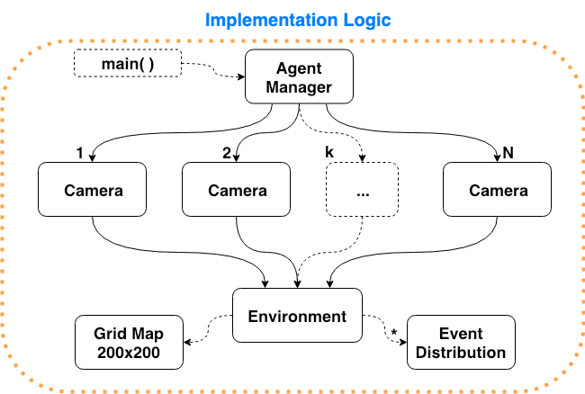

Slide 20
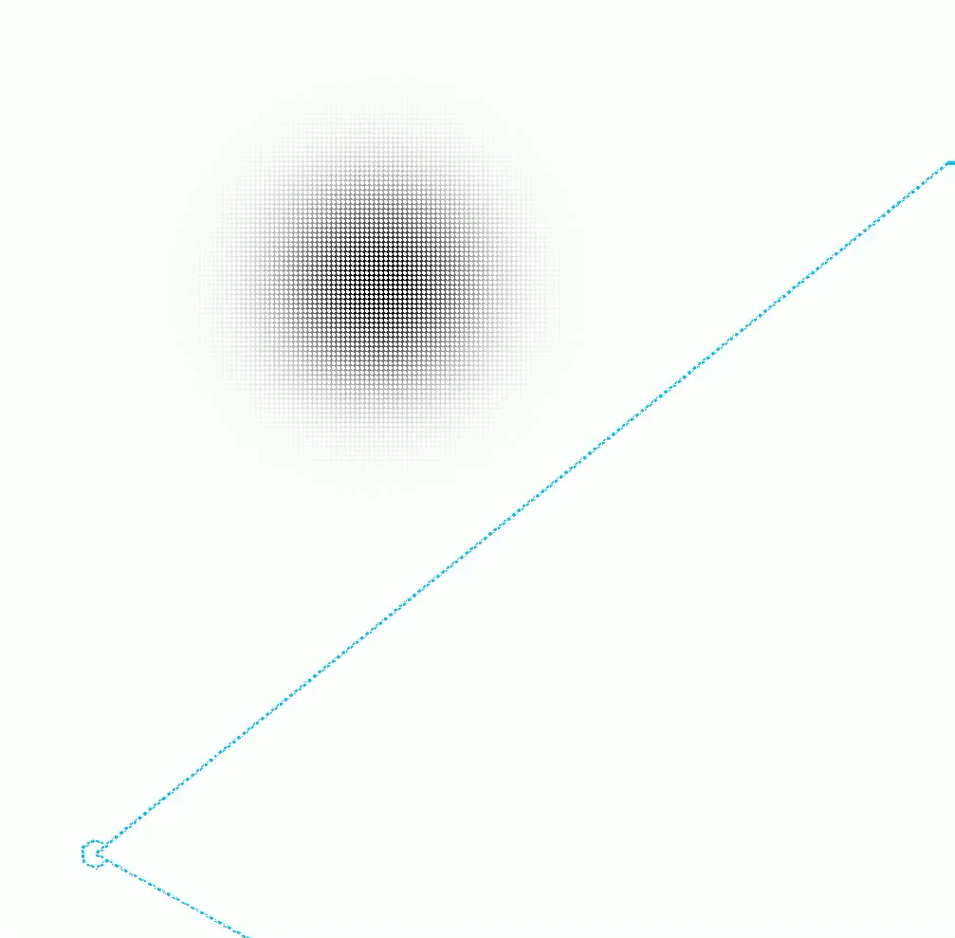
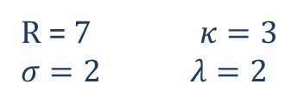
Single camera convergence
R = 7 $κ=3$
$σ=2$ $λ=2$

Slide 21
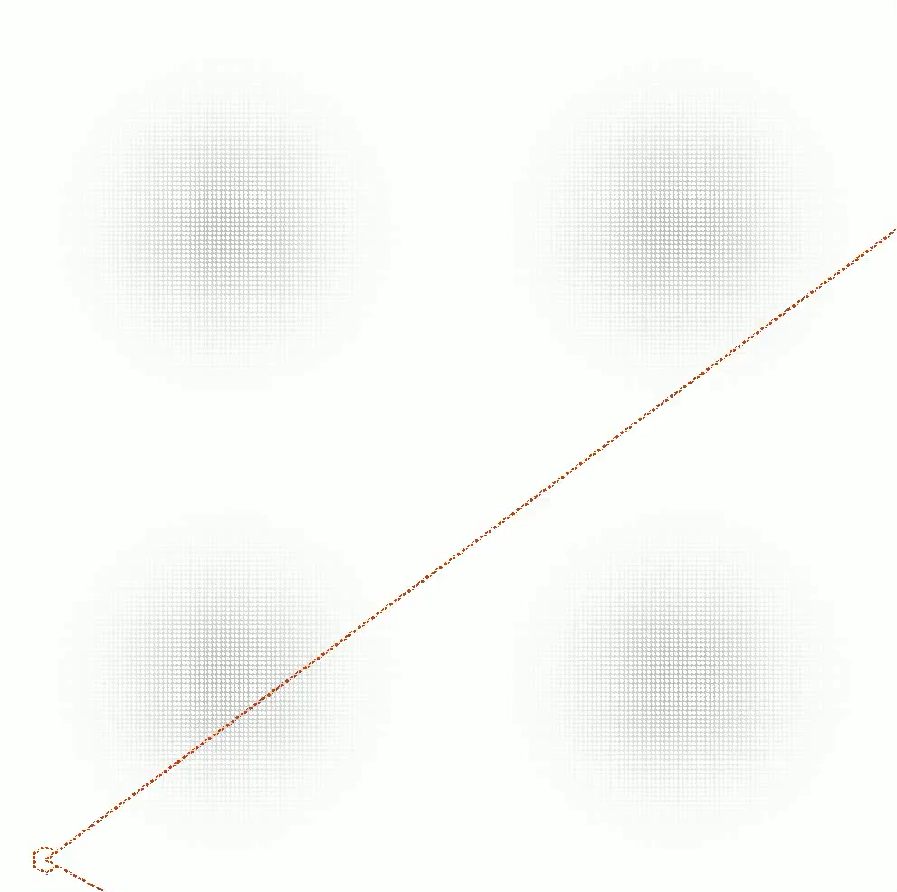
Each cam covers the farthest event
R = 7 $κ=3$
$σ=2$ $λ=2$

Slide 22
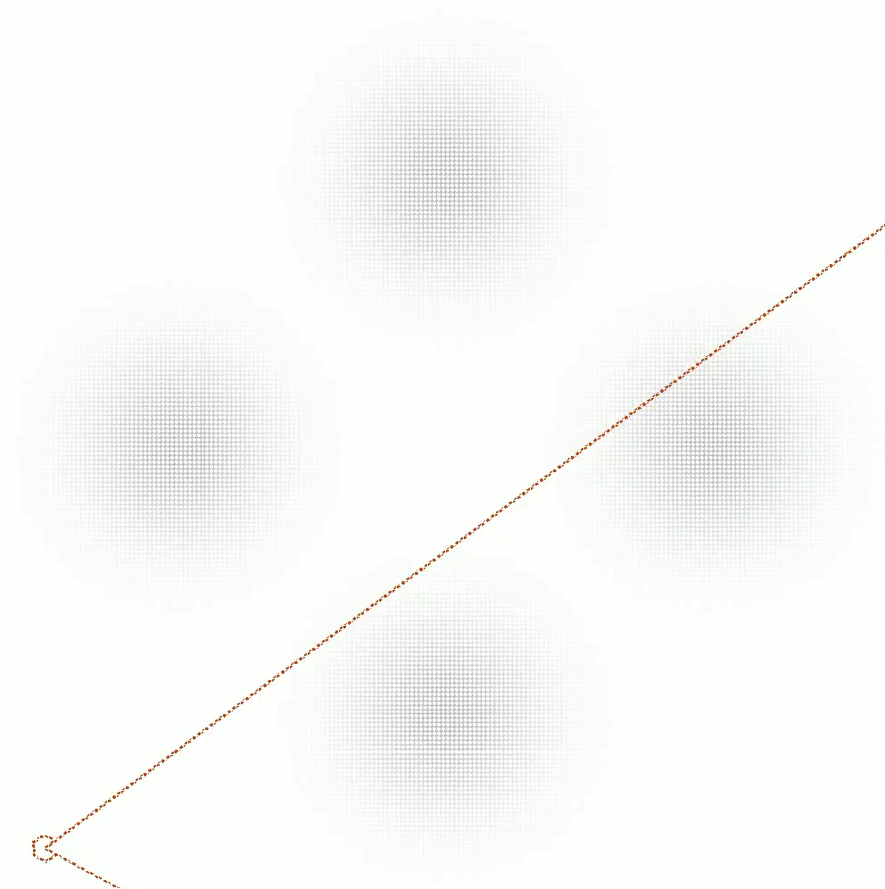
Each camera covers two events
R = 7 $κ=3$
$σ=2$ $λ=2$

Slide 23
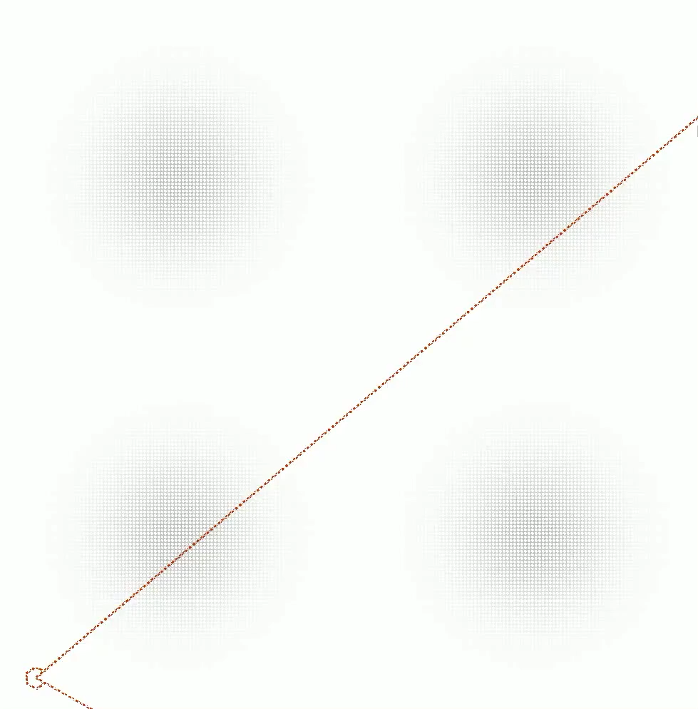
Cameras cover the event on their left
R = 7 $κ=3$
$σ=2$ $λ=2$

Slide 24
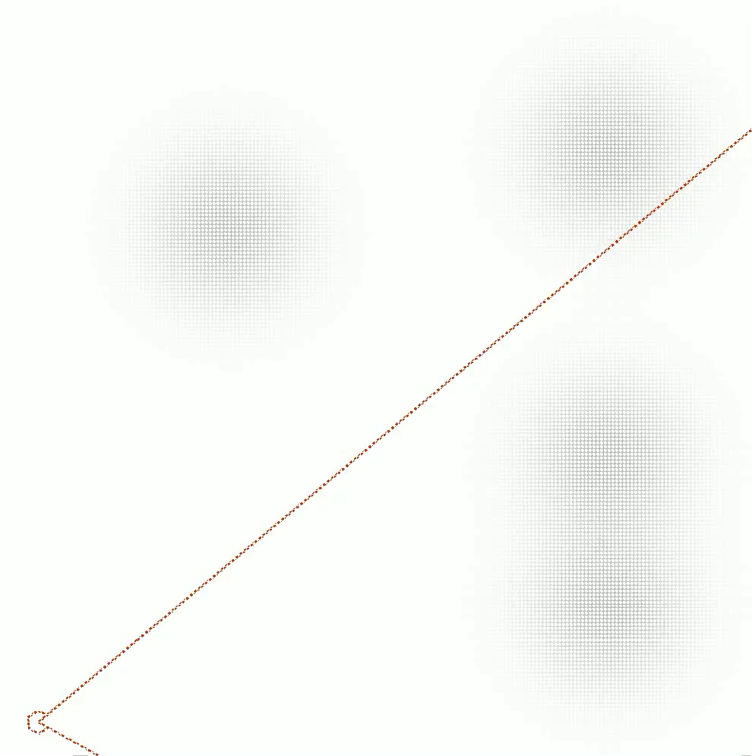
Complex event distribution coverage
R = 7 $κ=3$
$σ=2$ $λ=2$

Slide 25
Conclusions

Slide 26
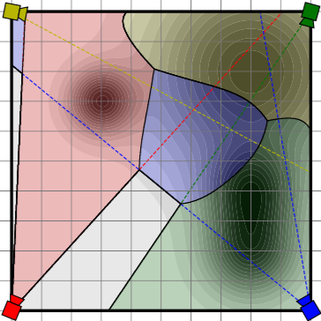
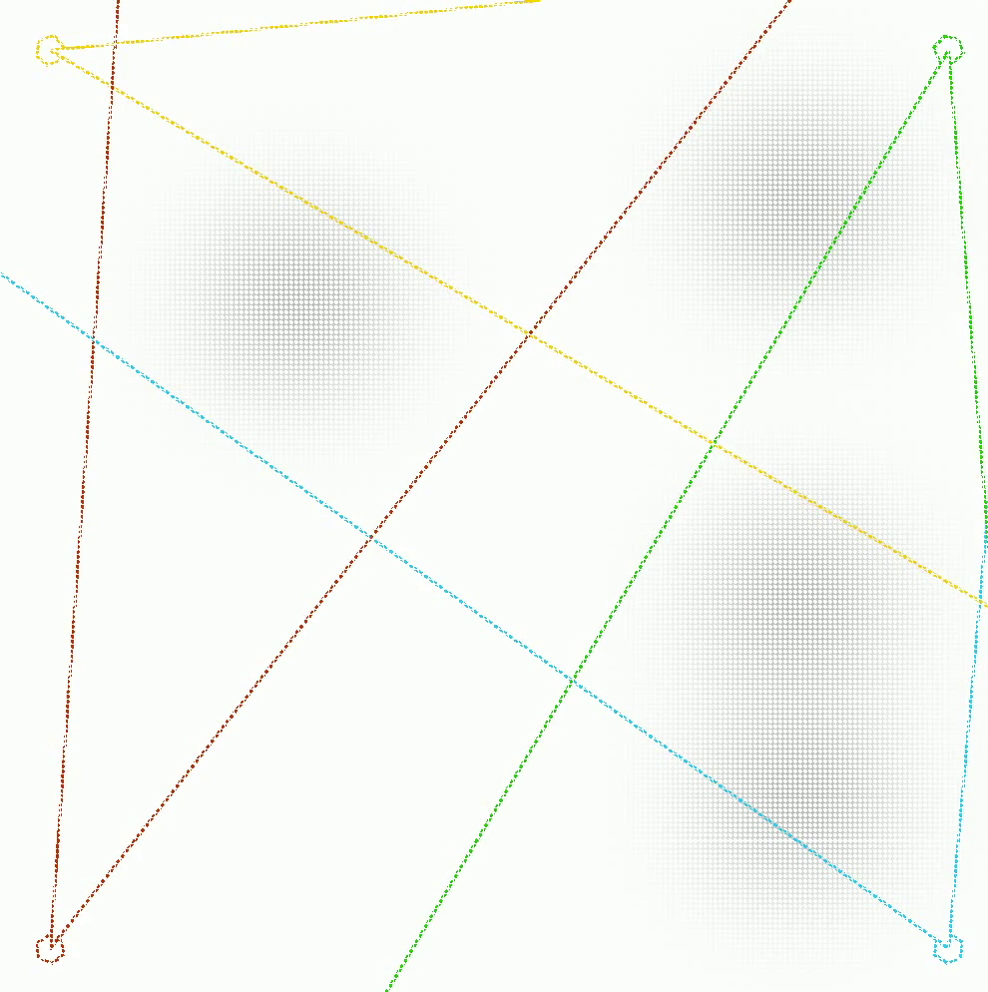
Contributions
Defined two new quality measures:
Perspective quality
Resolution quality
Introduced a greedy control law that, given an optimal conic Voronoi allocation, converges asymptotically to a locally optimal coverage configuration

Slide 27
Future improvements
Online vision-based event distribution estimation
Extension to non-convex environments and environments with visual occlusions
Optimal coverage control in mobile PTZ camera networks for active visual monitoring

